Slide 1
Project name: Regulatory Reporting – Sports Direct
Objective: The primary goal of this project was to aggregate and analyze transaction data for Sports Direct in order to meet regulatory reporting requirements for two distinct entities: R1 (representing the UK operations) and R2 (representing the US operations). This involved consolidating customer and transaction information, ensuring data accuracy through cleaning and validation, and producing actionable insights for reporting purposes.
Focus: The analysis specifically concentrated on distinguishing between cross-currency and same-currency transactions denominated in GBP over the period from April 1, 2022, to August 1, 2023. Cross-currency transactions are those where the start and end currencies differ, while same-currency transactions involve no currency conversion. The study aimed to provide both absolute monetary values and relative proportions, enabling a clear understanding of transaction volumes and trends for regulatory reporting.

Slide 2
Data Sources
The analysis leveraged two primary datasets—Customers and Transactions—to build a comprehensive view of Sports Direct’s transaction activity across the UK and US entities.
1. Customers Table
This table contains detailed information about individual customers, including:
customer_id: A unique identifier for each customer.
customer_type: Classification of the customer (e.g., retail, corporate, VIP).
current_address_country: The country of residence for the customer, used to determine entity affiliation (UK or US).
customer_since_date: The date when the customer first joined or transacted, providing historical context for customer activity.

Slide 3
2. Transactions Table This table captures transactional data for each customer, including:
transaction_id: A unique identifier for each transaction.
customer_id: Links the transaction to the corresponding customer in the Customers table.
amount_GBP: The transaction value in GBP, serving as the primary metric for analysis.
currency_route: Indicates the start and end currency for the transaction, enabling differentiation between cross-currency and same-currency transactions.
transaction_date: The date the transaction occurred, which was filtered for the period 01/04/2022 – 01/08/2023 for the reporting scope.
Relationship Between Tables The two tables were joined on customer_id to create a consolidated dataset. This allowed each transaction to be enriched with customer attributes, enabling entity-specific analysis and more accurate aggregation of cross-currency and same-currency GBP volumes.
Visual Suggestion: A simple diagram showing Customers → Transactions relationship, with arrows linking customer_id as the key join field.

Slide 4
Data Cleaning & Preparation
Removed duplicates: Ensure each transaction_id is unique.
Excluded negative values: Focus on positive GBP transactions only.
Standardized text fields: Trimmed whitespaces in customer_type and currency_route.
Joined tables: Merged Customers & Transactions on customer_id → created customer_transactions dataset.
Result: Clean, consolidated dataset ready for analysis and visualization.
Purpose: Ensures accurate aggregation of metrics for R1 (UK) and R2 (US) entities.
Next step: Use this dataset to calculate cross-currency vs same-currency transaction volumes.
Visual Suggestion: Simple flow diagram: Raw Customers & Transactions → Cleaning → Join → Customer_Transactions Dataset

Slide 5
Metrics Calculation
Cross-Currency vs Same-Currency:
Cross-Currency: Start and end currencies differ.
Same-Currency: Start and end currencies are the same.
R1 – UK Entity: Filter by current_address_country = 'UK' and transactions including GBP.
R2 – US Entity: Filter by current_address_country = 'USA' or transaction_origin_country = 'USA'.
Metric Types:
Absolute values: Total GBP volume per category.
Relative values: Percentage of total GBP volume.
Visuals: Bar and pie charts to compare cross vs same-currency transactions.

Slide 6
R1 – UK Entity Metrics
Filters applied:
current_address_country = 'UK'
Transactions including GBP
Date range: 01/04/2022 – 01/08/2023
Metrics:
Cross-Currency GBP: Total value of transactions with currency conversion
Same-Currency GBP: Total value of transactions without conversion
Relative values: Percentage of total GBP volume
Visuals:
Bar chart for absolute GBP values
Pie chart for relative proportions
Insight: Quickly compare cross-currency vs same-currency activity for the UK entity.

Slide 7
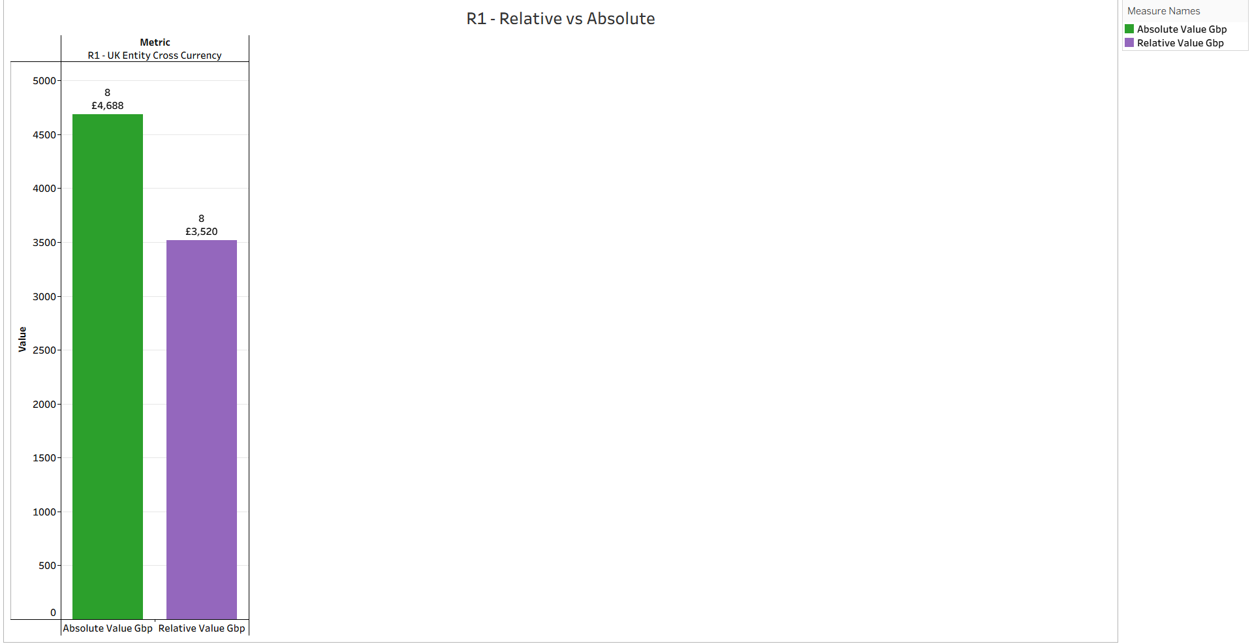

Slide 8
R2 – US Entity Metrics
Filters applied:
current_address_country = 'USA' OR transaction_origin_country = 'USA'
Date range: 01/04/2022 – 01/08/2023
Metrics:
Cross-Currency GBP: Total value of transactions with currency conversion
Same-Currency GBP: Total value of transactions without conversion
Relative values: Percentage of total GBP volume
Visuals:
Bar chart for absolute GBP values
Pie chart for relative proportions
Insight: Compare cross-currency vs same-currency activity for the US entity and identify trends relative to the UK entity.

Slide 9
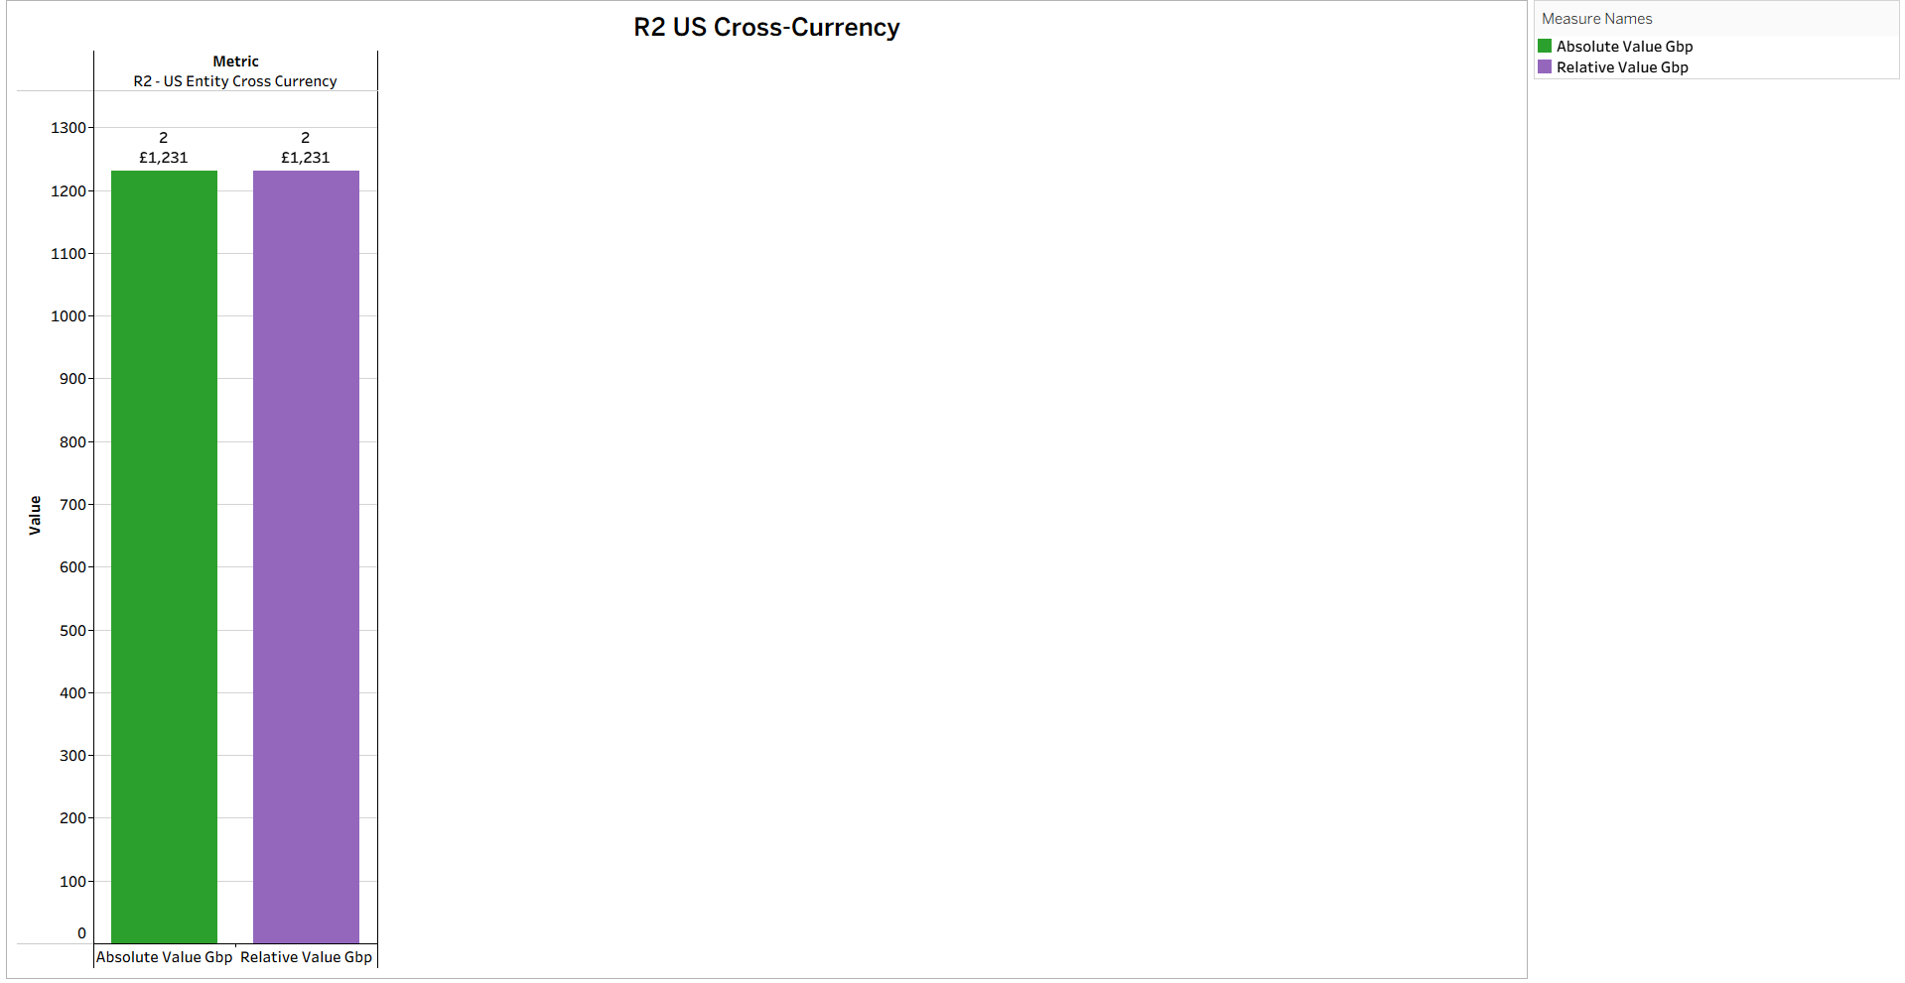

Slide 10
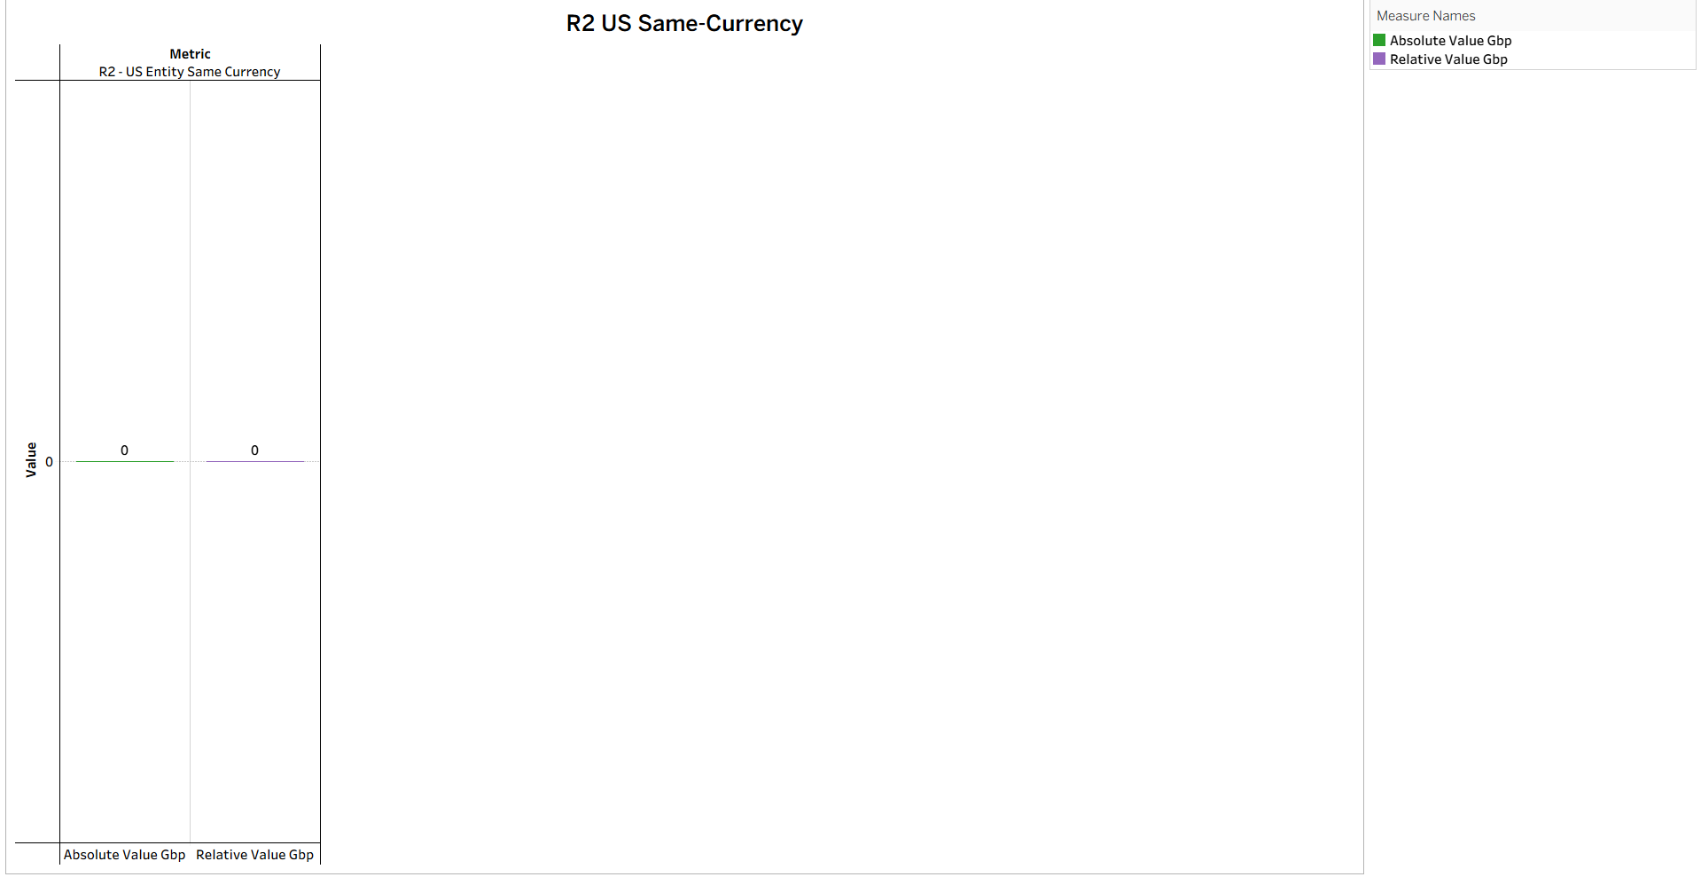
Some categories show zero values because there were no transactions recorded for that currency type or entity during the selected period.

Slide 11
Absolute vs Relative Values & Assumptions / Limitations
Absolute values: Represent total GBP transaction amounts for each category.
Relative values: Show the proportion of each category, highlighting trends and comparisons.
Assumptions:
UK and US entities defined by country fields
Cross/same-currency based on currency_route
Transactions limited to 01/04/2022 – 01/08/2023
Limitations:
Some transactions missing currency_route
Negative amounts excluded (refunds/reversals not included)
Exchange rates not applied; relative values may exaggerate small categories
Visual suggestion: Example chart showing absolute vs relative comparison

Slide 12
SQL Logic & Methodology
Data Extraction: Imported Customers & Transactions CSVs into BigQuery.
Data Cleaning: Removed duplicates, negative values, trimmed text fields.
Table Join: Merged Customers & Transactions on customer_id → customer_transactions dataset.
Metrics Calculation:
Identified cross-currency vs same-currency transactions
Aggregated absolute and relative GBP values for R1 (UK) & R2 (US)
Validation: Checked for missing values, duplicates, and zero-value transactions.
Visualization: Prepared charts in Tableau to compare metrics across entities.
Visual suggestion: Flow diagram showing SQL steps → Metrics → Charts

Slide 13
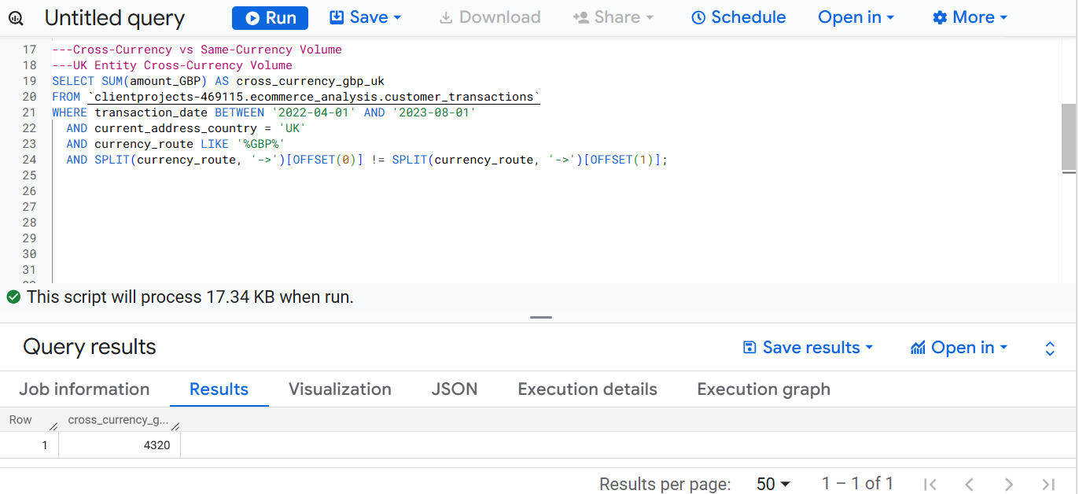
Example SQL snippet used to calculate UK cross-currency GBP volume (R1):

Slide 14
Regulatory Reporting Workflow & Tools
Workflow Steps:
Data Extraction: Import Customers & Transactions CSVs into BigQuery
Data Cleaning: Remove duplicates, negative values, trim text fields
Aggregation: Join tables & calculate metrics (cross vs same-currency)
Validation: Check for missing values, duplicates, zero transactions
Visualization: Prepare charts in Tableau
Slide Pack Creation & Submission: Summarize findings and share with stakeholders
Data Extraction
Data Cleaning
Aggregation
Validation
Visualization
Tools & Technologies: BigQuery (data storage & querying), SQL & Excel/Sheets (data cleaning & preparation), Tableau Desktop/Public (visualization), Google Slides/PowerPoint/PDF (reporting & slide pack)

Slide 15
Key Insights & Conclusion
Key Insights:
R1 (UK) vs R2 (US) show different levels of cross-currency activity
Relative values highlight clear trends over time
Zero or missing categories indicate limited or no activity in some segments
Conclusion / Next Steps:
Cleaned and aggregated data enabled accurate reporting for both entities
Absolute & relative views provided both scale and proportion insights
Future improvements: include refunds/chargebacks, factor in exchange rates, and automate dashboards for ongoing monitoring

Slide 16
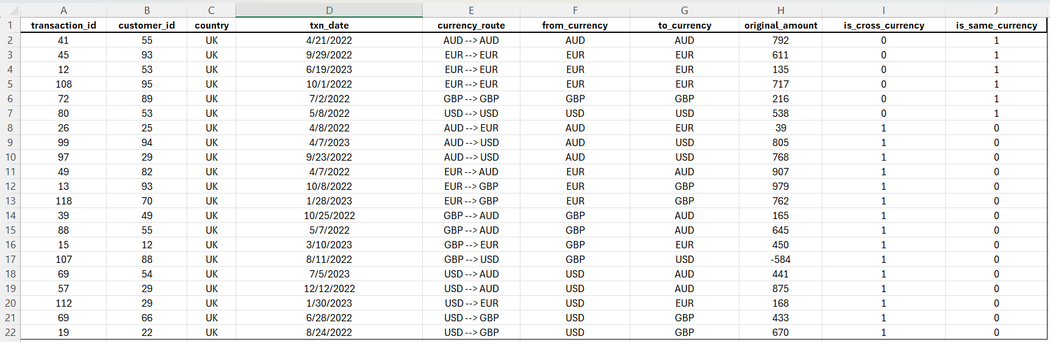
Appendix – Detailed Records (UK Example)

